Slide 1
PCA & SVD
薛犇 吴润迪

Slide 2
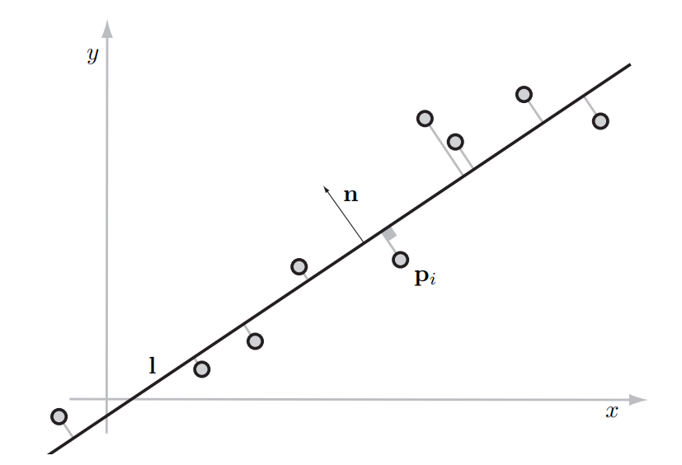
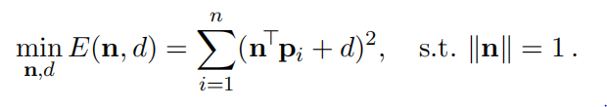
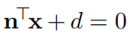
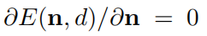
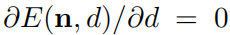
Principal Component Analysis
Start from a problem in least-square solution, fit one line
Minimize the total distance from all points to the line.
line l :
Similar to previous solution:

Slide 3
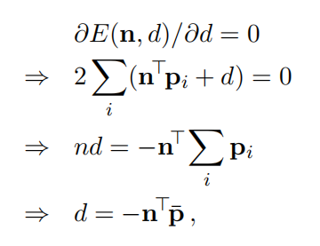
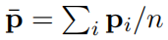
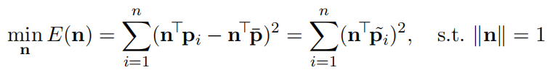
Principal Component Analysis
is the centroid of the given point set P .

Slide 4
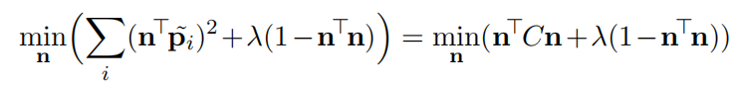
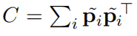
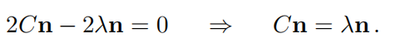
Principal Component Analysis
Use Laplacian form:
is the covariance matrix of the given point set.
Setting the partial derivative of the above expression w.r.t n to zero, and using rules of matrix differentiation, we arrive at:
Thus, n is one of the eigenvectors of covariance matrix C.

Slide 5
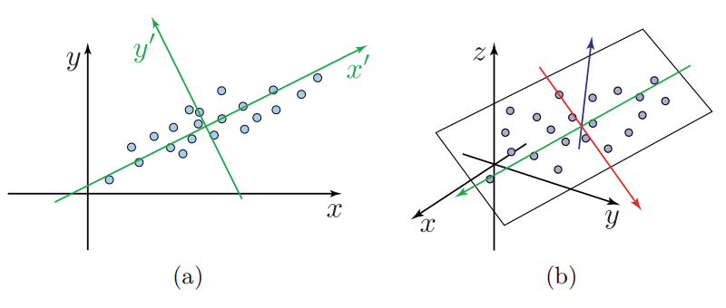
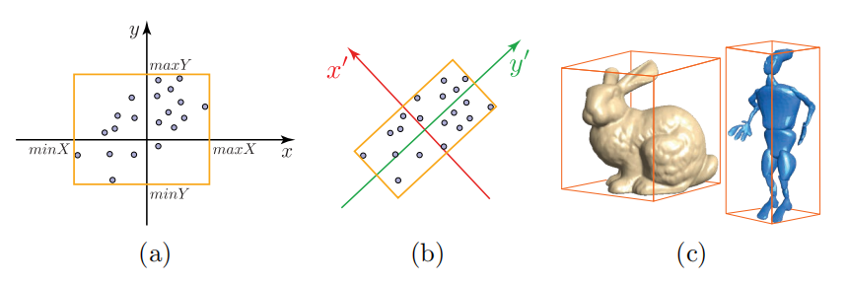
Principal Component Analysis
Principal component analysis finds orthogonal axes that represent the input points well in terms of linear structures

Slide 6
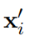
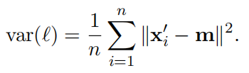
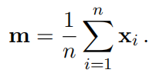
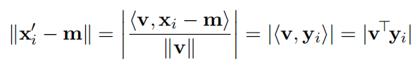
PCA: Problem & Solution
We need to find the directions that represents our data best.
The variance of the projected points measures how far they are spread away from the center
m is the mass(centroid of point set) :
Define the direction of line l by v, and assume that v is normalized.
So we can replace the projected points in the expression of covariance:

Slide 7
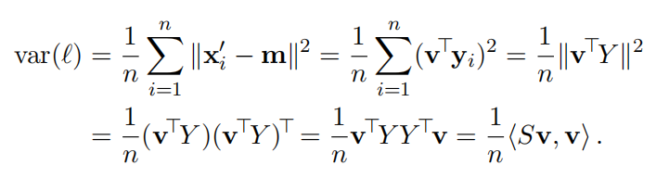
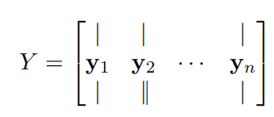
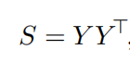
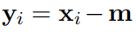
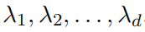
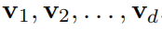
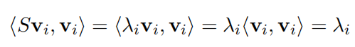
PCA: Problem & Solution
S is the scatter(covariance) matrix:
Eigenvalues: Eigenvectors:
The extremal values of the variance are, therefore:

Slide 8
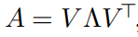
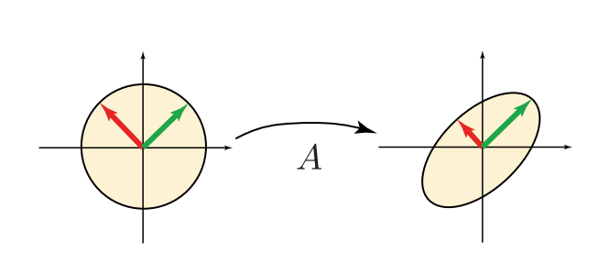
Singular Value Decomposition
Given a transformation A, let’s see what it does geometrically:
If we are lucky, then , V being orthogonal, meaning A is symmetric, and the eigenvectors of A are axes of the ellipse:
The eigendecomposition of A tells us which orthogonal exes it scales.

Slide 9
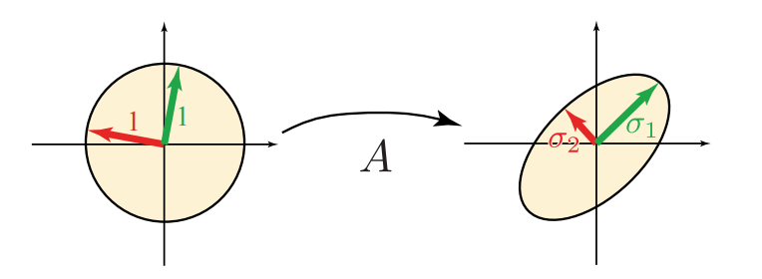
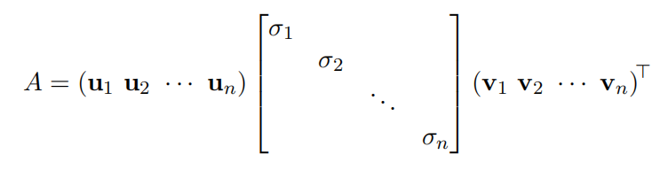
Singular Value Decomposition
However, in general, A also contains rotations, not just scaling along orthogonal axes.
A then looks like this:

Slide 10
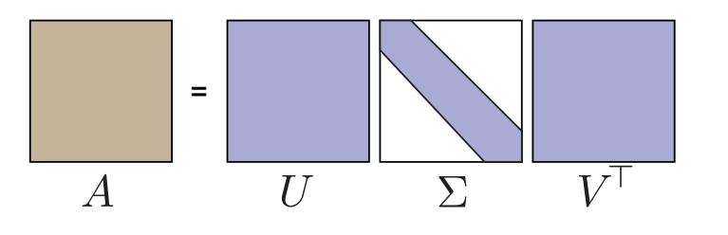
Singular Value Decomposition
Σ is a matrix with values on diagonal that are real and nonnegative
U and V are orthogonal matrices
SVD exists for any matrix of any dimension

Slide 11
SVD: Algorithms
Solutions:
Golub Kahan
Jacobi Rotation

Slide 12
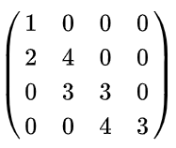
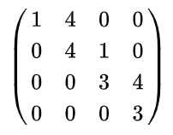
SVD: Algorithms - Golub Kahan
Pipeline:
Householder transformation, convert it to a bidiagonal matrix
QR algorithm to approximate the eigenvalue of this bidiagonal matrix
a bidiagonal matrix is a matrix with non-zero entries along the main diagonal and either the diagonal above or the diagonal below

Slide 13
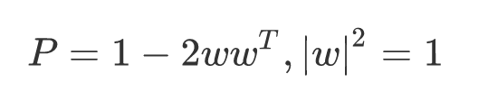
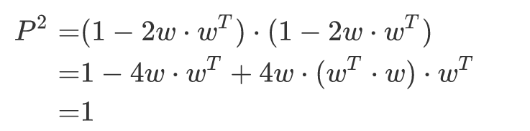
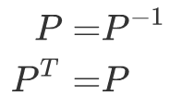
SVD: Algorithms - Golub Kahan
A Householder matrix P:
Therefore:
P is orthogonal

Slide 14
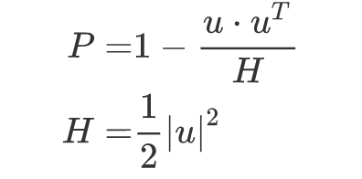
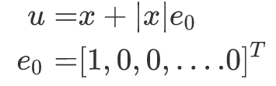
SVD: Algorithms - Golub Kahan
Change a form:
Now u can be any vector. Assume x is the first column of matrix A

Slide 15
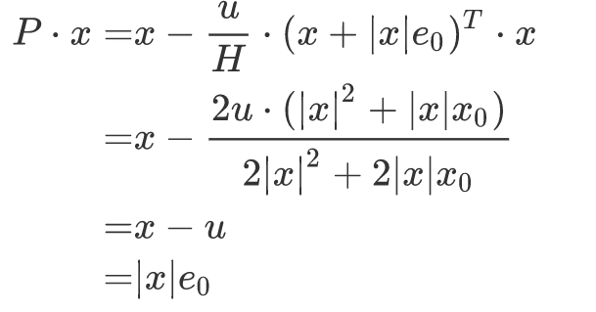
SVD: Algorithms - Golub Kahan
We have
So we can convert all elements in first column of A to 0 except the first one.
And then we can iteratively convert A to a bidiagonal matrix.

Slide 16
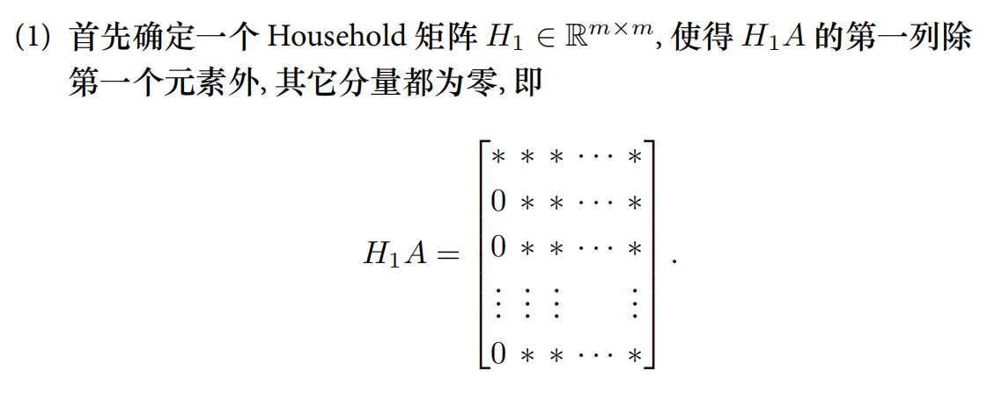
SVD: Algorithms - Golub Kahan (quote)
潘建瑜，华东师范大学数学系，《矩阵计算/数值线性代数》

Slide 17
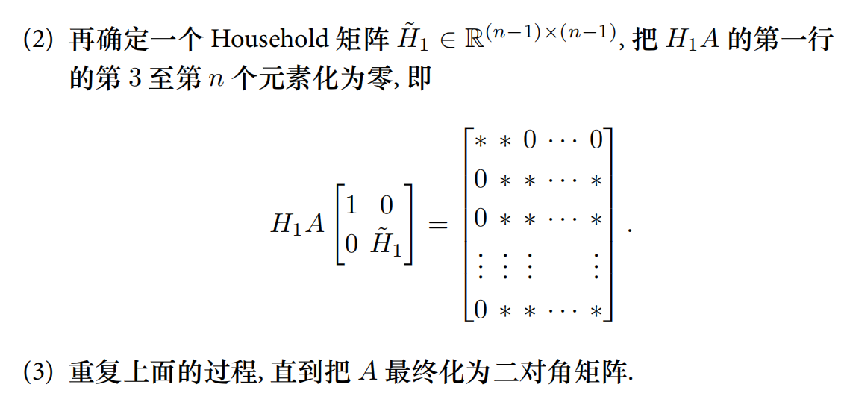
SVD: Algorithms - Golub Kahan (quote)
潘建瑜，华东师范大学数学系，《矩阵计算/数值线性代数》

Slide 18
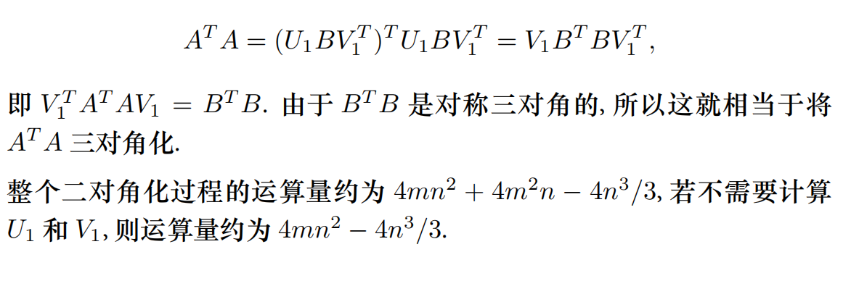
SVD: Algorithms - Golub Kahan (quote)
潘建瑜，华东师范大学数学系，《矩阵计算/数值线性代数》

Slide 19
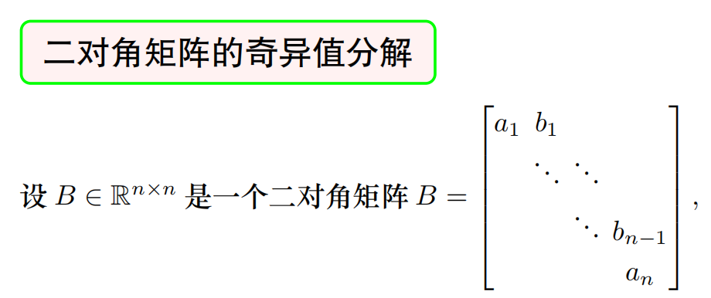
SVD: Algorithms - Golub Kahan (quote)
潘建瑜，华东师范大学数学系，《矩阵计算/数值线性代数》

Slide 20
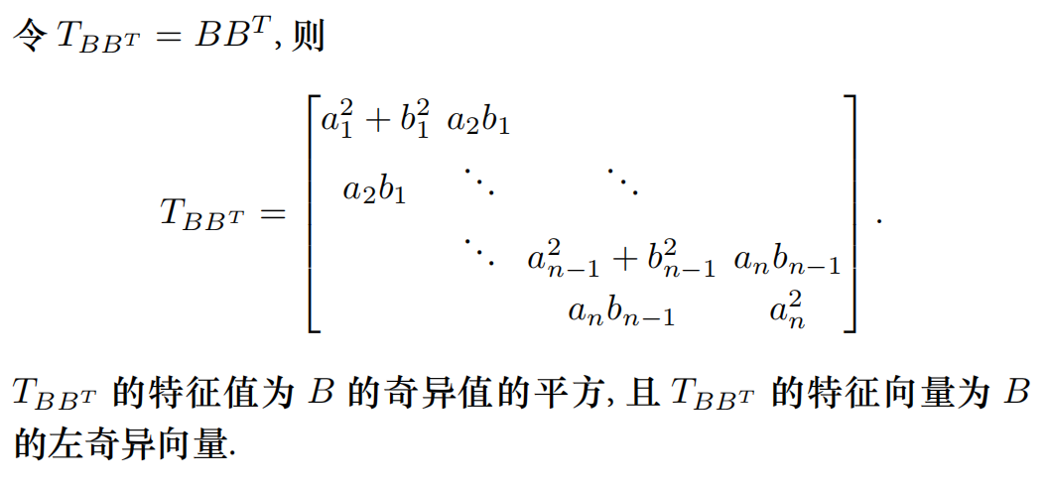
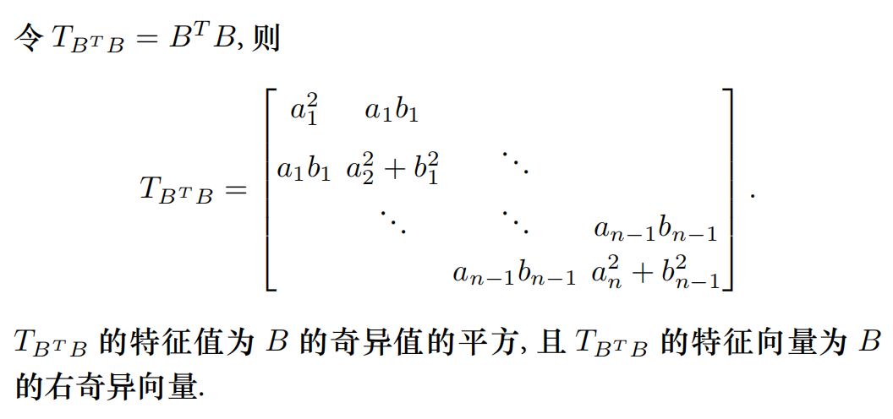
SVD: Algorithms - Golub Kahan (quote)
潘建瑜，华东师范大学数学系，《矩阵计算/数值线性代数》

Slide 21
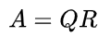
SVD: Algorithms - Golub Kahan
In application: use QR algorithm to calculate the eigenvector
Any real square matrix A may be decomposed as
Q is an orthogonal matrix and R is an upper triangular matrix
Formally, let A be a real matrix of which we want to compute the eigenvalues, and let A₀:=A. At the k-th step (starting with k = 0), we compute the QR decomposition A_{k}=Q_{k}R_{k} where Q_{k} is an orthogonal matrix (i.e., Q^{T} = Q⁻¹) and R_{k} is an upper triangular matrix. We then form A_{k+1} = R_{k}Q_{k}. Note that
so all the A_{k} are similar and hence they have the same eigenvalues. The algorithm is numerically stable because it proceeds by orthogonal similarity transforms.

Slide 22
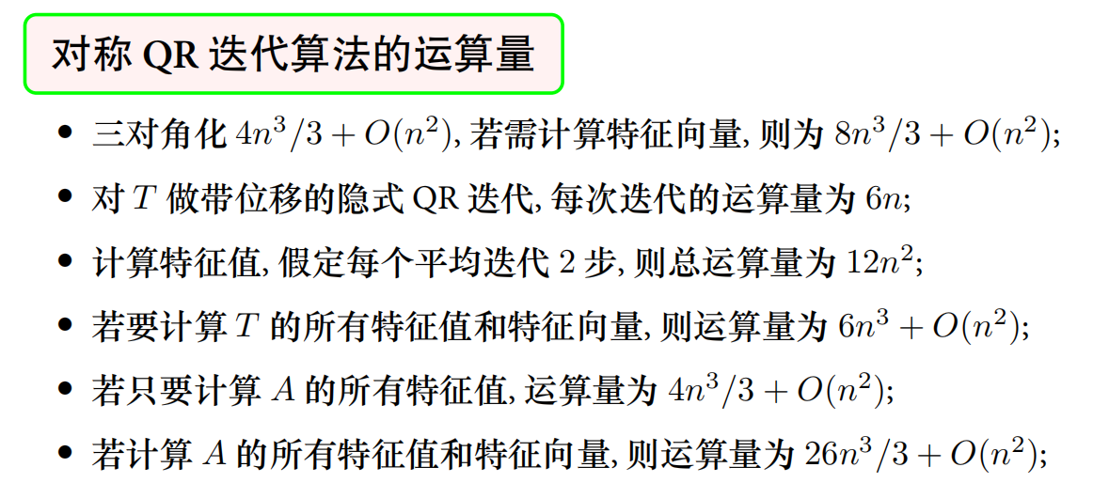
SVD: Algorithms - Golub Kahan (quote)
Why we use QR?
For common matrix, one iteration of QR decomposition cost O(n^3)
But for tridiagonal matrix, time cost is O(n)
潘建瑜，华东师范大学数学系，《矩阵计算/数值线性代数》

Slide 23
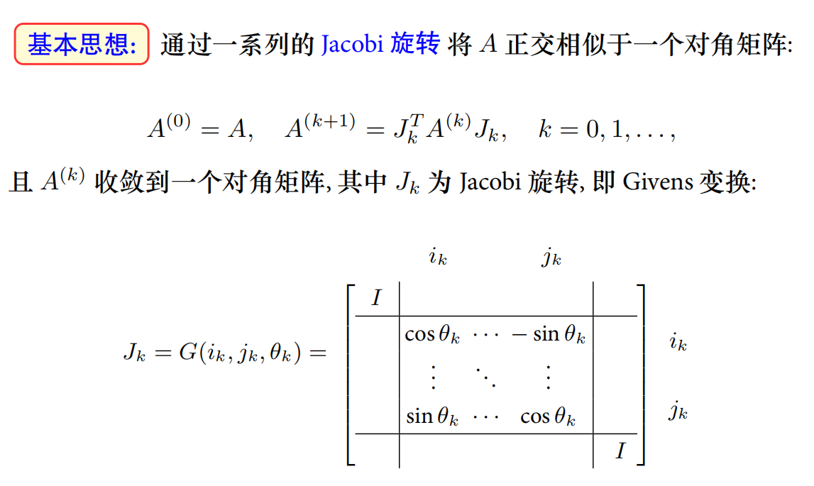
SVD: Algorithms - Jacobi Rotation (quote)
潘建瑜，华东师范大学数学系，《矩阵计算/数值线性代数》

Slide 24
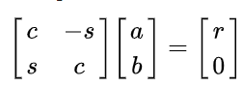
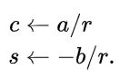
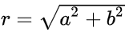
SVD: Algorithms - Jacobi Rotation
Givens Transformation, Consider:

Slide 25
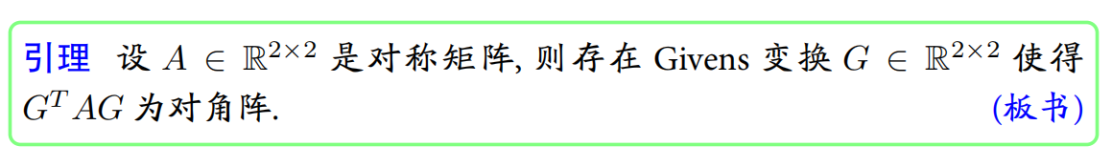

SVD: Algorithms - Jacobi Rotation (quote)
潘建瑜，华东师范大学数学系，《矩阵计算/数值线性代数》

Slide 26


SVD: Algorithms - Jacobi Rotation (quote)
潘建瑜，华东师范大学数学系，《矩阵计算/数值线性代数》

Slide 27

SVD: Algorithms - Jacobi Rotation (quote)
潘建瑜，华东师范大学数学系，《矩阵计算/数值线性代数》

Slide 28
Application
Find bounding box
Approximate normal of point cloud
Shape matching
3D animation compression by principal components
TensorTextures: multilinear image-based rendering

Slide 29
Find bounding box

Slide 30

Approximate normal of point cloud
Compute the PCA of its local neighboring points
The direction of the normal is simply the direction of the third eigenvector, corresponding to the smallest eigenvalue.

Slide 31

Shape matching
Align two shapes in correspondence by a rigid transformation

Slide 32


Shape matching - formalization
Align two point sets
Find a translation vector t and rotation matrix R such that:

Slide 33


Shape matching - solution
It turns out that we can solve for the translation and rotation separately.
If (R, t) is the optimal transformation, then the points {$p_{i}$} and {${Rq}_{i}+t$} have the same centers of mass.

Slide 34


Shape matching - solution
To find the optimal R, we bring the centers of both point sets to the origin:
$$p_{i}←p_{i}−p, q_{i}←q_{i}−p$$
Now we want to find R that minimizes

Slide 35


Shape matching - solution
Given the orthogonality of R, we have $R^{T}R=I$ and hence
where the first and last terms do not depend on R and the middle two terms are scalars.
Notes:
第三项应该是R的转置

Slide 36




Shape matching - solution
Thus we have
Since $p_{i}^{T}Rq_{i}={{(p}_{i}^{T}Rq_{i})}^{T}=p_{i}^{T}R^{T}q_{i}$, we actually have

Slide 37



Shape matching - solution
Let
So we want to find R that minimizes

Slide 38



Shape matching - solution
Now we only need to find R such that RH is symmetric positive definite. Then we know for sure Trace(RH) is maximal.
Compute SVD of H
Define
which is symmetric and its eigenvalues are positive.

Slide 39

Shape matching - solution
Summary

Slide 40





3D animations compression
Each frame is a 3D-model
Geometry – 3D coordinates of the vertices
When the number of vertices is huge, how to represent it?

Slide 41

3D animations compression
Only describe key frames $B_{i}$.
Additional frames are generated by interpolation between two consecutive key frames. $A\left(t\right)=\sum_{i}{a_{i}\left(t\right)⋅B_{i}}$.
Still there is some redundancy.
3N × f

Slide 42


3D animations compression
Find a few new vectors in $R^{3N}$ that can best describe our frames.

Slide 43




3D animations compression
Taking the first k principle components
According to the property of SVD, it is the best rank k approximation of the original matrix.
u₁
u₂
u₃
V^{T}
$$≈$$

Slide 44

3D animations compression
Approximate each frame by linear combination of the first a few principal components.
u₁
u₂
u₃
$α_{1}$…… ……
$α_{2}$…… ……
$α_{3}$…… ……
u₁
u₂
u₃
$$≈$$
=
α₁
+ α₂
+ α₃

Slide 45


TensorTexture: purely image-based rendering
A framework that learns a parsimonious model of the bidirectional texture function (BTF) from observational data.
BTF is a function of six variables $\left(x,y,θ_{v},φ_{v},θ_{i},φ_{i}\right)$, where $(x,y)$ are surface parametric (texel) coordinates and where $(θ_{v},φ_{v})$ is the view direction and ${(θ}_{i},φ_{i})$ is the illumination direction.
TensorTextures: Multilinear Image-Based Rendering, M. Alex O. Vasilescu and Demetri Terzopoulos
Notes:
Given an ensemble of images of a textured surface, our nonlinear, generative model explicitly represents the multifactor interaction implicit in the detailed appearance of the surface under varying photometric angles, including lo- cal (per-texel) reflectance, complex mesostructural self-occlusion, interreflection and self-shadowing, and other BTF-relevant phe- nomena.

Slide 46


TensorTexture: Tensor and N-mode SVD
A tensor is a higher order generalization of a vector (1st-order tensor) and a matrix (2nd-order tensor).
The mode-n vectors are the column vectors of matrix $A(n)∈ R^{I_{n}×(I_{1}× I_{2}…I_{n−1}× I_{n+1} …I_{N})}$that results from flattening the tensor A
The mode-n product of a tensor $A ∈R^{I_{1}× I_{2}…I_{n} …{×I}_{N}}$and a matrix $M∈R^{J_{n}×I_{n}}$ is denoted by $A ×_{n} M$. The result can be expressed in terms of flattened matrices as $B(n) = MA(n).$
TensorTextures: Multilinear Image-Based Rendering, M. Alex O. Vasilescu and Demetri Terzopoulos

Slide 47


TensorTexture: Tensor and N-mode SVD
The N-mode SVD is a generalization of the SVD that orthogonalizes these N spaces and decomposes the tensor as the mode-n product of the N orthogonal spaces:
Tensor $Z$, known as the core tensor, is analogous to the diagonal singular value matrix in conventional matrix SVD.
$U_{n}$ contains the orthonormal vectors spanning the column space of the matrix $D(n)$ that results from the mode-n flattening of $D$
SVD can be rewritten as
TensorTextures: Multilinear Image-Based Rendering, M. Alex O. Vasilescu and Demetri Terzopoulos
Notes:
A matrix D ∈ IRI1 ×I2 is a two-mode mathematical object with two associated vector spaces, a row space and a column space. The SVD orthogonalizes these two spaces and decomposes the matrix as D = U1SUT2 , the product of an orthogonal column-space represented by the left matrix U1 ∈ IRI1 ×J1 , a diagonal singular value matrix S ∈ IRJ1 ×J2 , and an orthogonal row space represented by the right matrix U2 ∈ IRI2 ×J2 .

Slide 48


TensorTexture: Tensor and N-mode SVD
Calculate N-mode SVD
TensorTextures: Multilinear Image-Based Rendering, M. Alex O. Vasilescu and Demetri Terzopoulos

Slide 49



TensorTexture: Tensor and N-mode SVD
Analogous to the optimal dimensional reduction in PCA resulting from the truncation of eigenvectors
Here it admits similar scheme and offers more control, enabling a tailored truncation of each mode.
$D=Z{ ×}_{1}{ U}_{1}{ ×}_{2}{ U}_{2}{ ×}_{3}{ U}_{3}$
TensorTextures: Multilinear Image-Based Rendering, M. Alex O. Vasilescu and Demetri Terzopoulos

Slide 50






TensorTexture: multilinear rendering
Given an ensemble of images of a textured surface, we define an image data tensor $D ∈ R^{T×I×V}$
$V, I$:number of different view and illumination conditions
$T$: the number of texels in each texture image
TensorTextures: Multilinear Image-Based Rendering, M. Alex O. Vasilescu and Demetri Terzopoulos

Slide 51


TensorTexture: multilinear rendering
Apply the N-mode SVD algorithm to decompose this tensor $D ∈ R^{230400×21×37}$.
Analogous to the standard SVD $A=UDV^{T}$, where the column vectors of $U$ span the view space,
The column vectors of the 37 × 37 mode matrix $U_{view}$ span the view space. The rows of $U_{view}$ encode an illumination and texel in- variant representation for each of the different views.
TensorTextures: Multilinear Image-Based Rendering, M. Alex O. Vasilescu and Demetri Terzopoulos

Slide 52


TensorTexture: multilinear rendering
The column vectors of the 230400 × 777 mode matrix $U_{texel}$ span the texel space and are, in fact, the PCA eigenvectors (i.e. “eigentextures”) since they were computed by performing an SVD on the matrix D(texel) obtained by mode-1 flattening the data tensor D
TensorTextures: Multilinear Image-Based Rendering, M. Alex O. Vasilescu and Demetri Terzopoulos

Slide 53


TensorTexture: multilinear rendering
TensorTextures models how the appearance of a textured surface varies with view and illumination:
TensorTextures: Multilinear Image-Based Rendering, M. Alex O. Vasilescu and Demetri Terzopoulos
Notes:
Thus, TensorTextures transform“eigentextures”into a tensorial representation of the variation and co-variation of modes, characterizing how viewing parameters and illumination parameters interact and multiplicatively modulate the appearance of a surface .

Slide 54

TensorTexture: multilinear rendering
It decomposes the image ensemble into 37 × 21 basis vectors of the same dimension, and represents each image by two coefficient vectors, one of length 37 to encode the view and the other of length 21 to encode the illumination.
TensorTextures: Multilinear Image-Based Rendering, M. Alex O. Vasilescu and Demetri Terzopoulos
Notes:
Thus, TensorTextures transform“eigentextures”into a tensorial representation of the variation and co-variation of modes, characterizing how viewing parameters and illumination parameters interact and multiplicatively modulate the appearance of a surface .

Slide 55

TensorTexture: multilinear rendering
TensorTexture basis leads to a straightforward rendering algorithm. To render an image d, compute
where v and l are the view and illumination representation.
Given a novel view direction, find the three nearest observed view and represent the novel view as a convex combination of them.
TensorTextures: Multilinear Image-Based Rendering, M. Alex O. Vasilescu and Demetri Terzopoulos
Notes:
Thus, TensorTextures transform“eigentextures”into a tensorial representation of the variation and co-variation of modes, characterizing how viewing parameters and illumination parameters interact and multiplicatively modulate the appearance of a surface .

Slide 56
Reference
https://pdfs.semanticscholar.org/6d92/8a2f8fbf93812b03d077508dfa9c7dbda4d1.pdf. 3d animation compression.
https://dl.acm.org/citation.cfm?id=1015725 TensorTexture.
https://www.google.com.hk/search?safe=active&biw=1220&bih=738&ei=Uf74W62hJcrYvgSXgamYDg&q=svd+for+graphics&oq=svd+for+&gs_l=psy-ab.3..35i39l2j0i20i263j0l7.46.4126..5499...8.0..0.490.5002.4-11......0....1..gws-wiz.....6..0i67j0i131.4hKaXXRsPVw SVD and Its Applications
https://www.cs.tau.ac.il/~dcor/Graphics/cg-slides/3d_geometry_lesson2.pdf 3d geometry for computer graphics
Notes:
Thus, TensorTextures transform“eigentextures”into a tensorial representation of the variation and co-variation of modes, characterizing how viewing parameters and illumination parameters interact and multiplicatively modulate the appearance of a surface .

